Slide 1
Deep Belief Network
Deep belief network (DBN) is a generative graphical model, or alternatively a type of deep neural network.
Consists multiple layers of "hidden units", with connections between the layers but not between units within each layer.
DBNs can be viewed as a composition of simple, unsupervised networks where each sub-network's hidden layer serves as the visible layer for the next

Slide 2
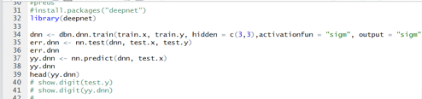
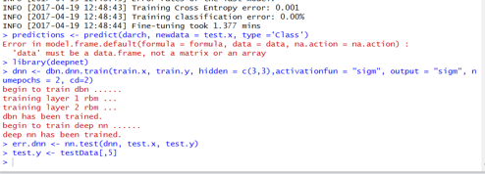
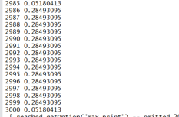
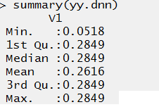

Deep Belief Network
CODE:
DBN Model
Predictions and summary of predictions

Slide 3
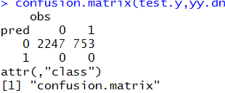
Deep Belief Network
RESULT:
Accuracy
Confusion Matrix

